Slide 1

Data Mining
CRISP‑DM & Modern Analytics
Instructor: Warren Macevoy Term: Fall 2025 Colorado Mesa University
[1][2][3][4]

Slide 2


Orientation & Data Mindset
Understand the CRISP‑DM cycle
Identify real‑world problems in analytics
Tools: Python, pandas, git & MLflow
Prerequisites: CS0–CS2, statistics
[1][2]

Slide 3

Wrangling & Exploratory Analysis
Tidy data structures & schemas
Cleaning: missingness, outliers, type conversions
Join, merge & reshape dataframes
EDA: histograms, scatter matrices, correlation heatmaps
[1][2]

Slide 4
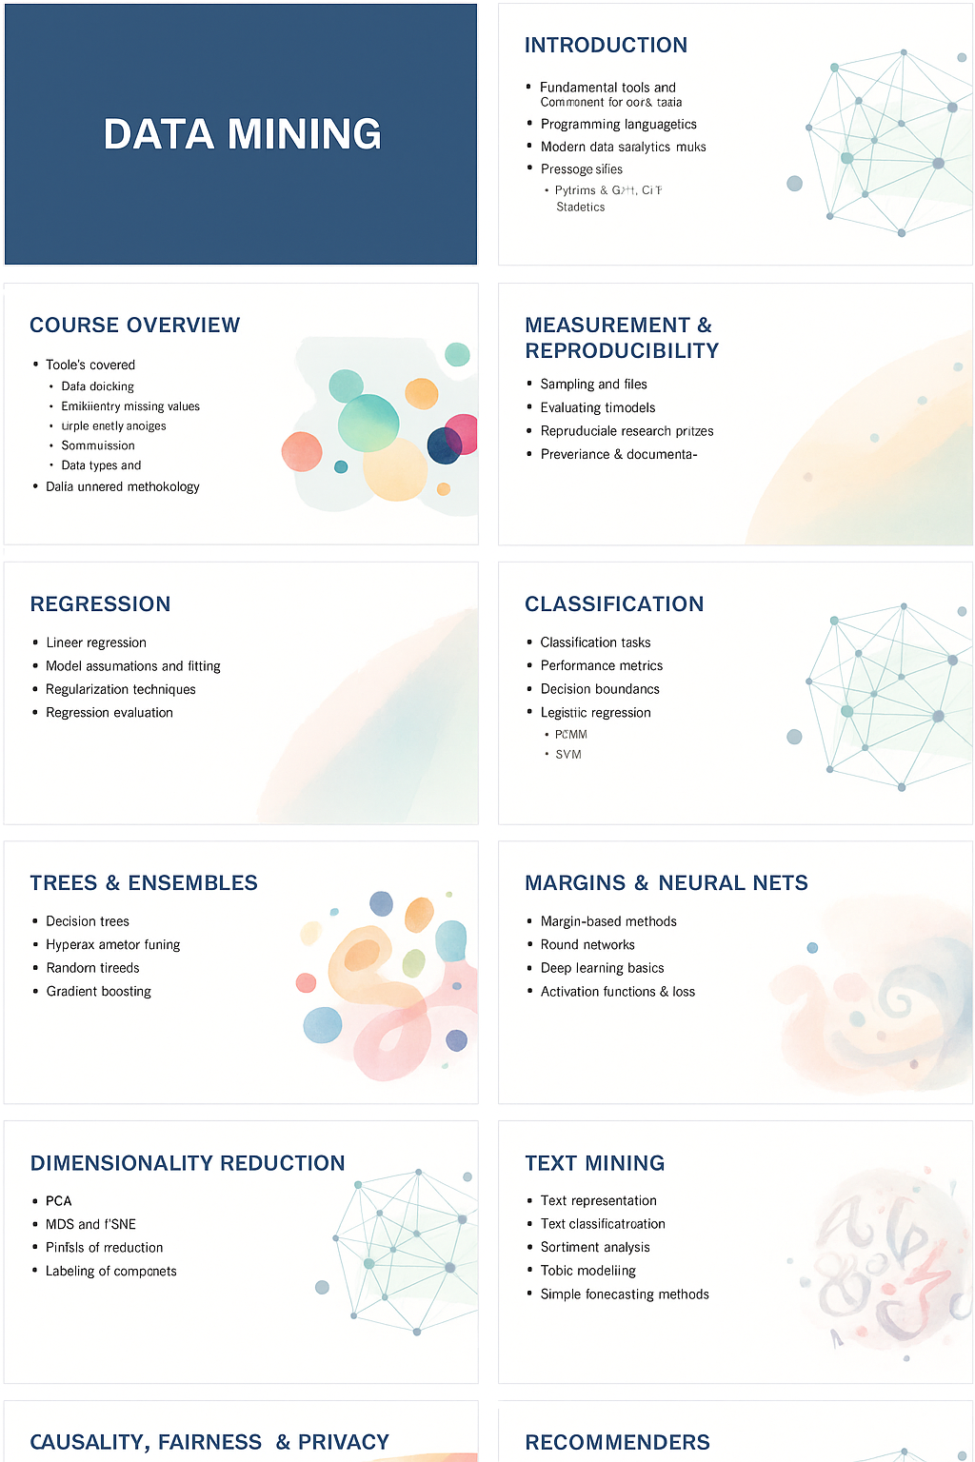
Measurement & Reproducibility
Train/validation/test splits & cross‑validation
Metrics: MSE, MAE, accuracy, ROC‑AUC, PR‑AUC
Avoid leakage and proper sampling
Reproducible pipelines with git & MLflow
[1][2]

Slide 5
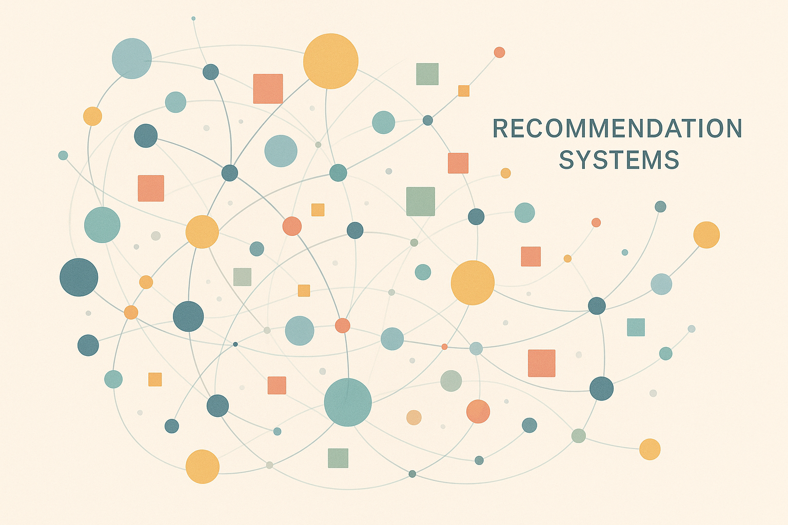
Supervised Learning
Regression: linear models, regularization (Ridge/Lasso)
Classification: logistic regression, kNN, Naïve Bayes
Model evaluation: confusion matrix, ROC/PR curves
Handling class imbalance & calibration
[1][2]

Slide 6
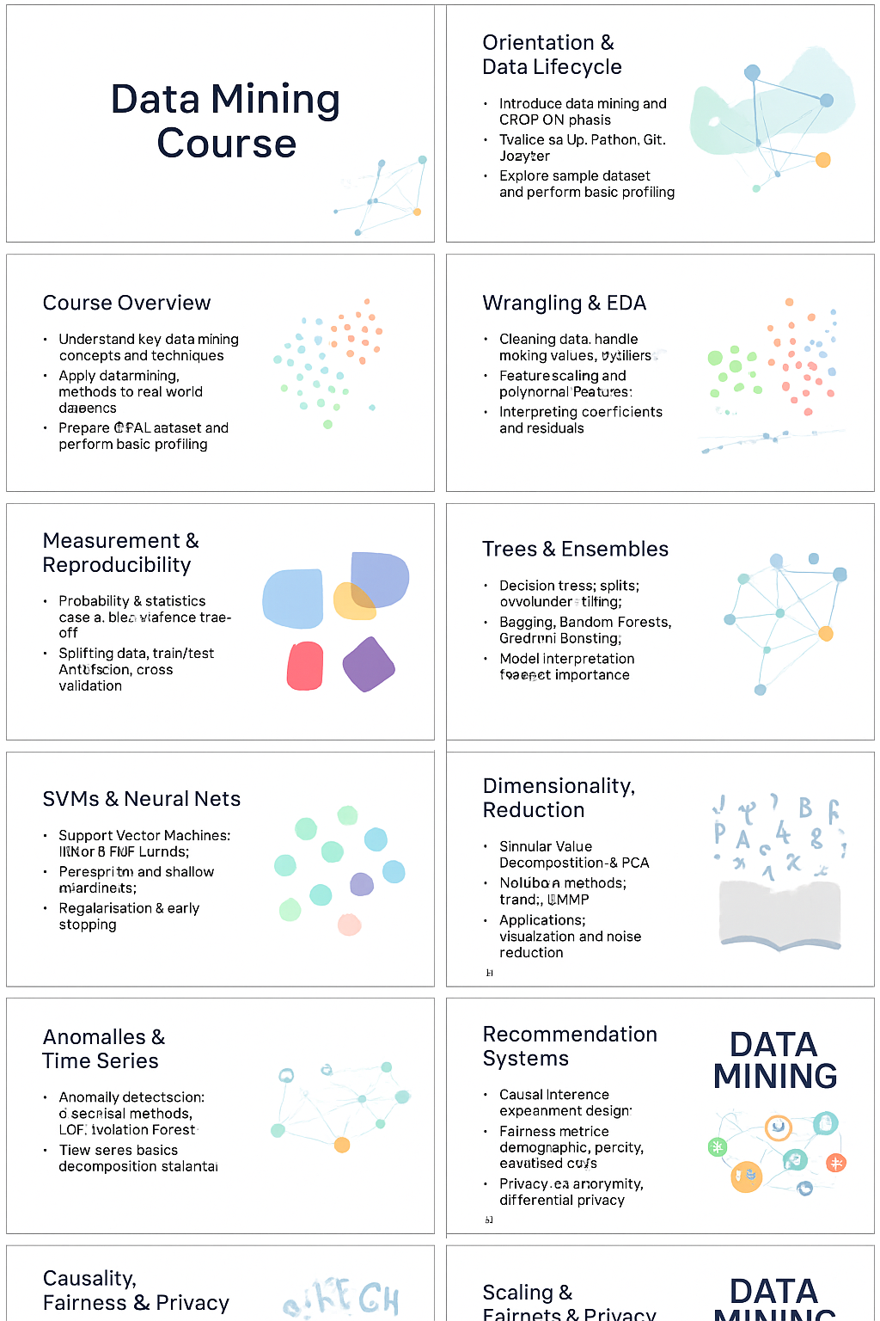
Trees, Ensembles & Interpretation
Decision trees: splits, depth & pruning
Ensembles: bagging, random forests, boosting (XGBoost)
Interpretability: feature importance, SHAP & PDP
Bias‑variance trade‑off & tuning
[1][2]

Slide 7
Margins & Neural Networks
Support Vector Machines: linear & RBF kernels
Margins & slack variables; when SVMs shine
Perceptron → Multi‑layer Perceptrons; overfitting & early stopping
[1]

Slide 8
Clustering & Unsupervised Learning
Distance measures & scaling
k‑means, hierarchical clustering & DBSCAN
Choosing k; silhouette & Davies‑Bouldin indices
Clustering pitfalls & interpretation
[1][2]

Slide 9
Dimensionality Reduction & Patterns
PCA & SVD for linear subspaces
t‑SNE & UMAP for nonlinear visualization
Association rules: Apriori/Eclat; support & lift
Sequential pattern mining; evaluation & pruning
[1][2]

Slide 10
Anomalies, Time Series & Text
Anomaly detection: robust stats, LOF, Isolation Forest
Time series: decomposition, ARIMA & boosted trees
Text mining: TF‑IDF, n‑grams, embeddings & topic models
[1][2]

Slide 11
Recommenders, Fairness & Privacy
Collaborative filtering: memory‑ & model‑based
Matrix factorization & implicit feedback
Evaluation: MAP, NDCG & cold start
Fairness metrics & mitigation; privacy (k‑anonymity & DP)
[1]

Slide 12
Scaling, MLOps & Final Project
From notebooks to pipelines: versioning & CI/CD
Distributed processing: Spark & Dask overview
Monitoring drift & retraining triggers
Team project: reproducibility, ethics & communication
[1][2][3]

